Slide 1
Industry Applications of CNNs
Prof. Sushree S. Behera
IIIT Bangalore

Slide 2
Agenda
CNN Fundamentals and Applications
Case Study 1: Retail / E-commerce – Visual Product Categorization
Case Study 2: Healthcare – Detection of Diabetic Retinopathy
Comparative Insights

Slide 3
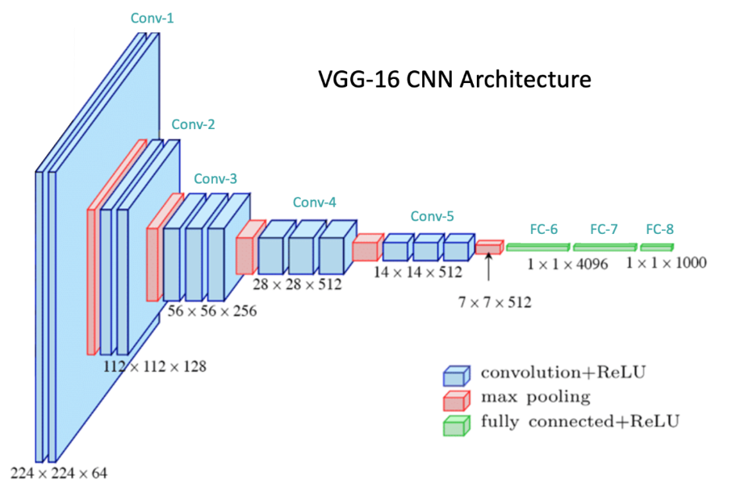
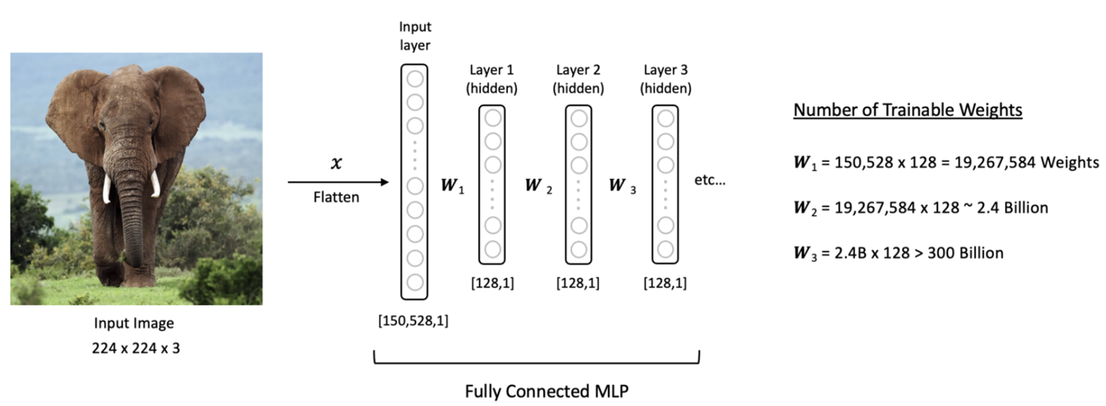
Convolutional Neural Networks
Designed to work with grid-structured inputs, with strong spatial dependencies in local regions.
Convolutional Layer
Pooling Layer
Fully-connected Layer
https://learnopencv.com/understanding-convolutional-neural-networks-cnn/
https://cs231n.github.io/convolutional-networks/#conv
Notes:
CNNs are designed to work with images, which are grid structured data with strong spatial dependency in the local regions. Three main layers of a CNN are convolutional layer, pooling layer and fully connected or dense layer. Multiple convolutional and pooling layers are connected in a feed-forward manner.

Slide 4
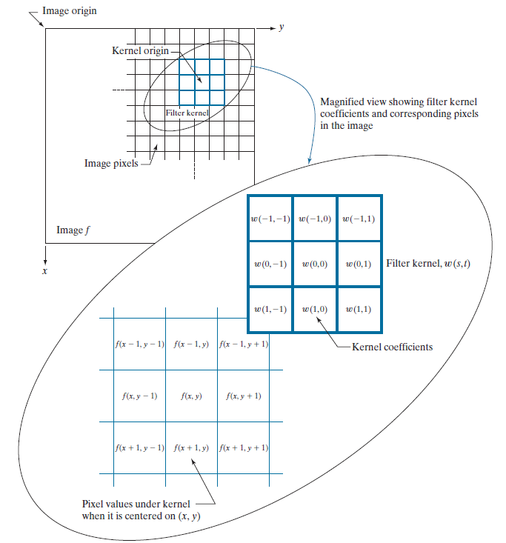

Convolutional Layer
Notes:
Convolution operation is the key operation in a convolutional layer, where a filter kernel is slid across an image through a sliding window operation. The output at each pixel is computed as sum of products between filter coefficients and the image pixels in the receptive field.

Slide 5
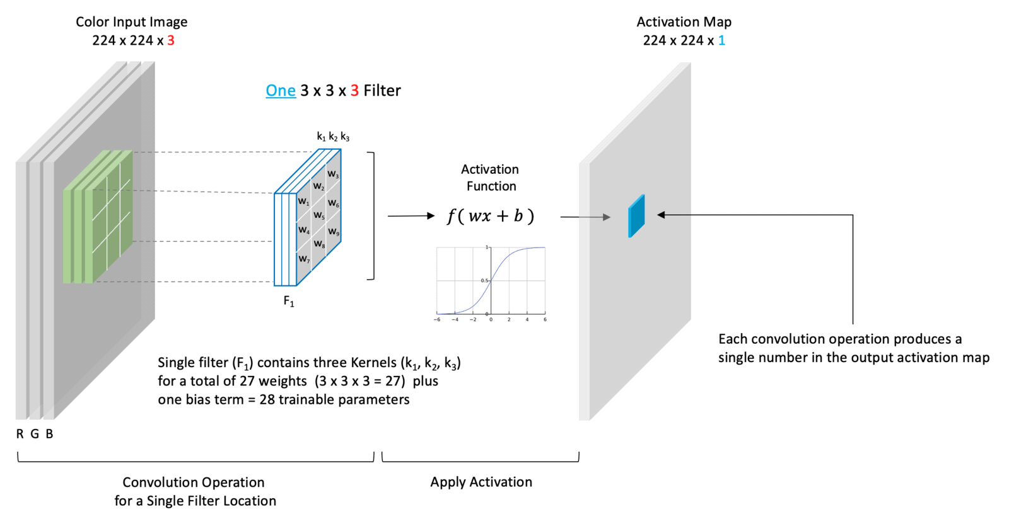
Convolutional Layer
https://learnopencv.com/understanding-convolutional-neural-networks-cnn/
Notes:
To the output of the convolution operation, a bias is added and the output is passed through a non-linear activation function. The number of kernels is a design choice and the number of channels in an activation map depends on the number of kernels.

Slide 6
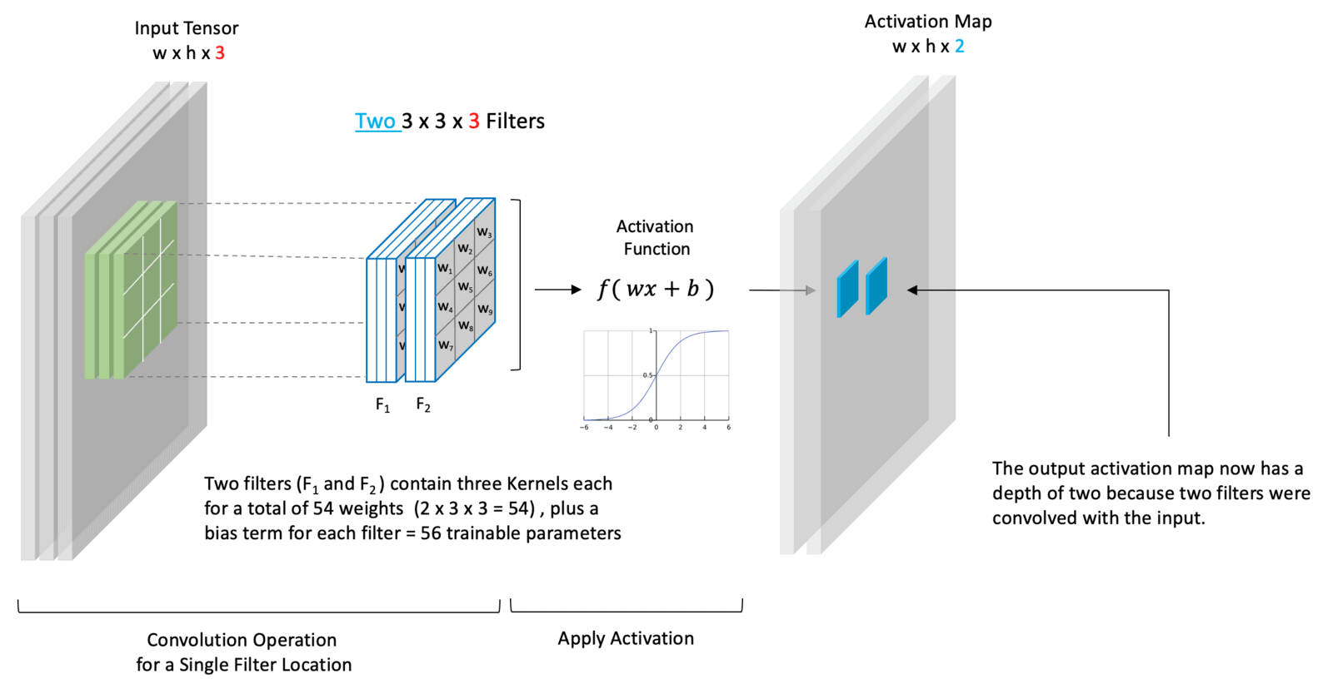
Convolutional Layer
https://learnopencv.com/understanding-convolutional-neural-networks-cnn/
Notes:
In this case, for example, two filter kernels give rise to an activation map with channel dimension of 2. In a convolutional layer, each kernel is associated with a set of weights and bias value, which are shared across the entire image. During training, each kernel learns something unique from the image.

Slide 7
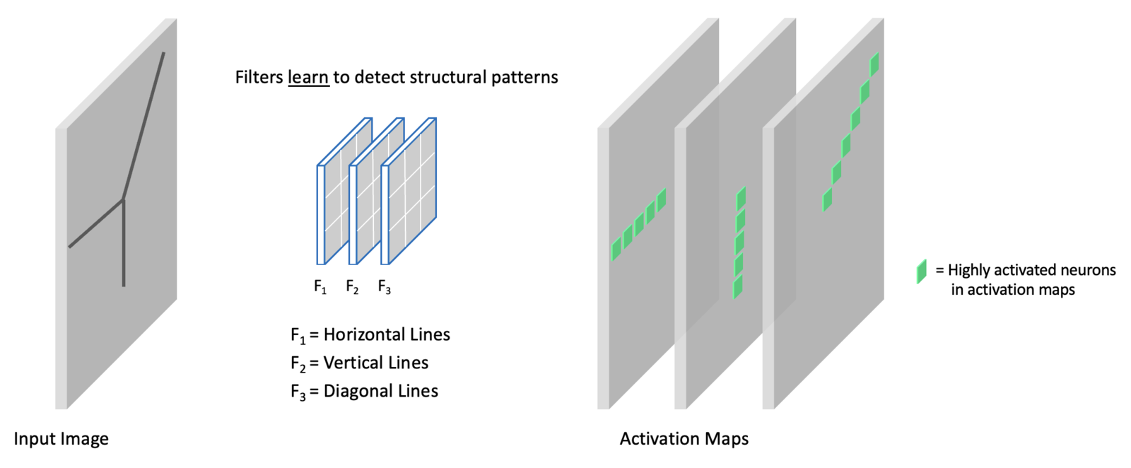
Convolutional Layer
https://learnopencv.com/understanding-convolutional-neural-networks-cnn/
Notes:
In this example, we see that three kernels learn three unique features from the entire image. In the next layer, the activation outputs work as input to the next layer and complex features are learned in a hierarchical manner.

Slide 8
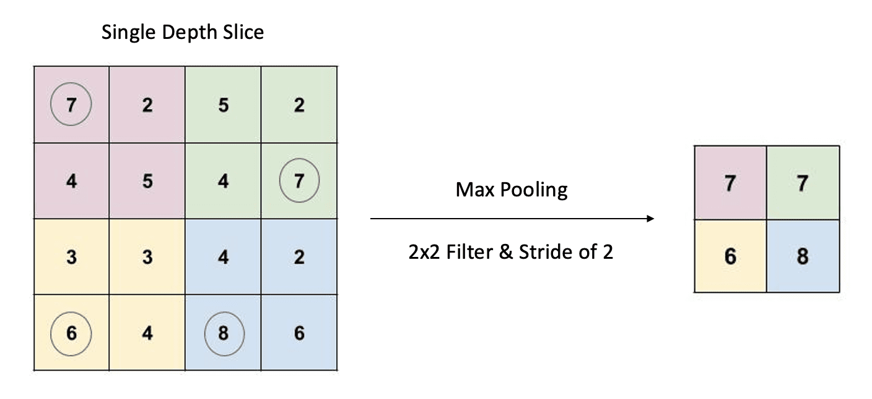
Pooling Layer
https://learnopencv.com/understanding-convolutional-neural-networks-cnn/c
Notes:
The pooling layers down sample the features using maxpooling or average pooling operation, the objective is to reduce the feature dimension so that the number of parameters are reduced.

Slide 9
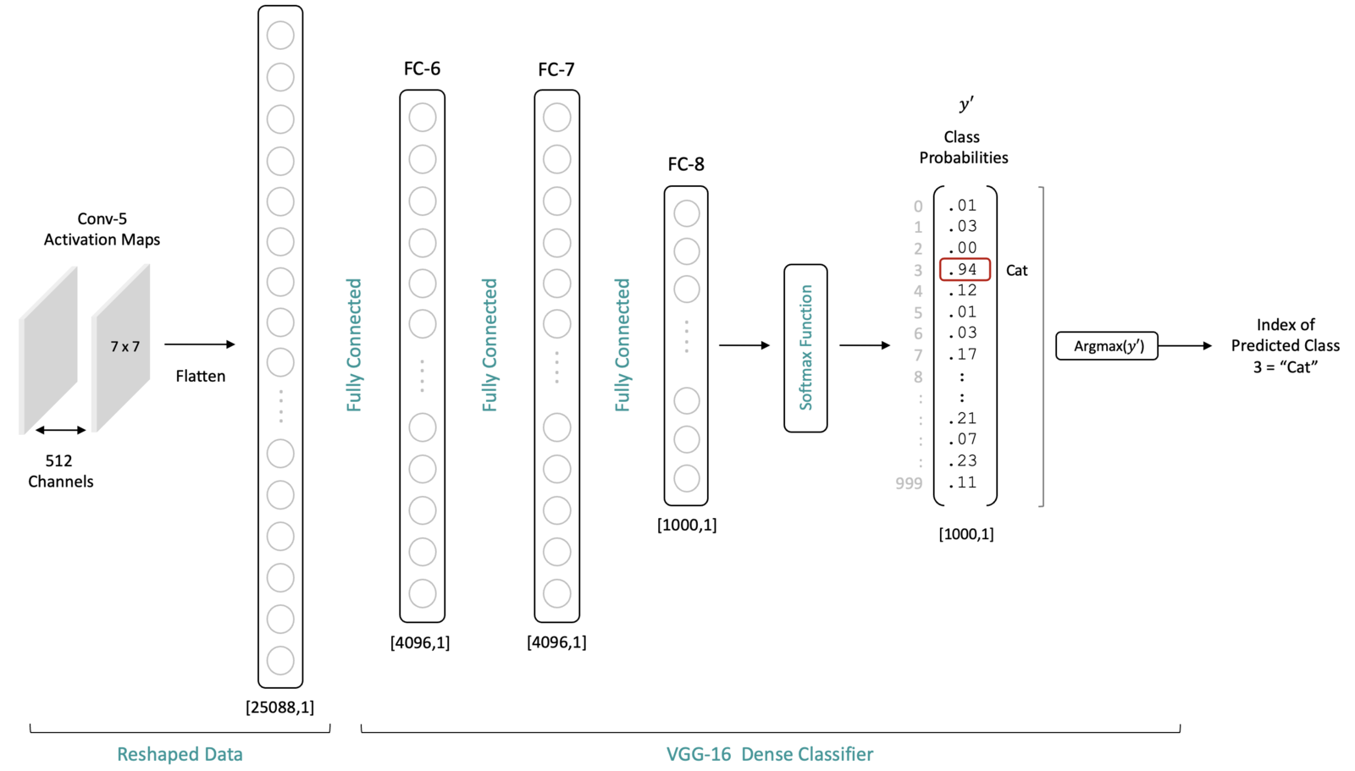
Fully-connected Layer
https://learnopencv.com/understanding-convolutional-neural-networks-cnn/
Notes:
The feature maps of the final pooling layer is flattened and then passed through the fully connected layers. These layers have dense connection between two consecutive layers. In the case of classification operation, Softmax activation function is used in the classification layer, which computes the probability of the image belonging to each class.

Slide 10
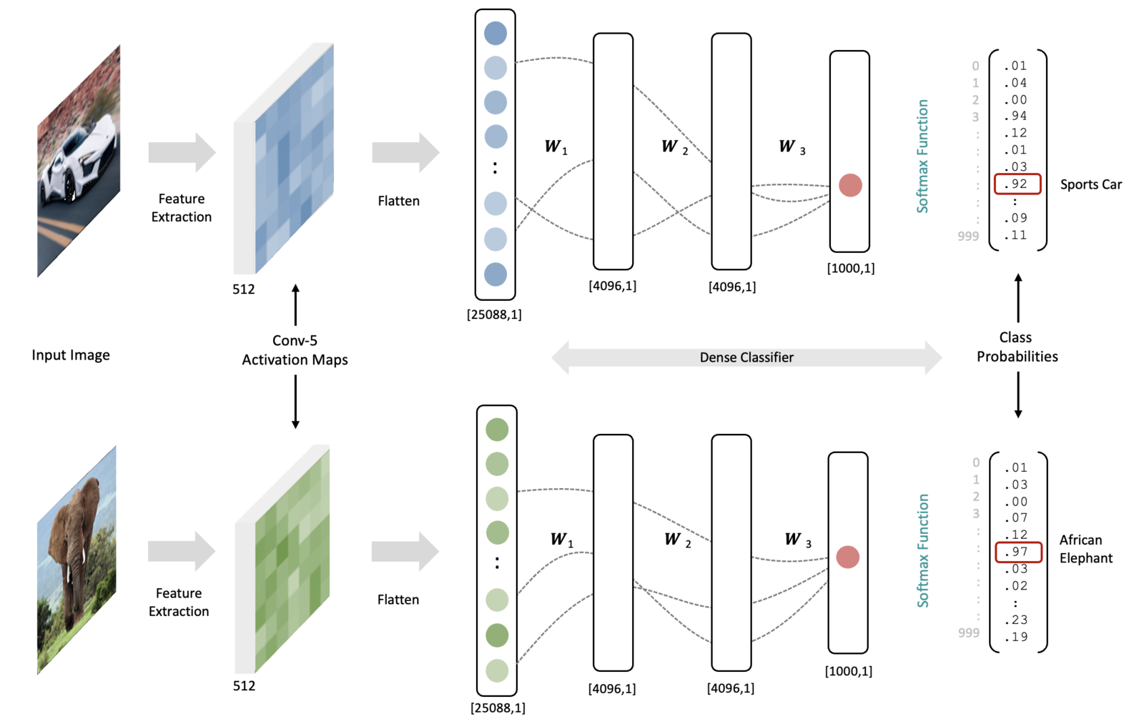
Convolutional Neural Networks
https://learnopencv.com/understanding-convolutional-neural-networks-cnn/
Notes:
In this image, given a trained CNN, given the image of a car or an elephant the same set of weights and bias give rise to highest probability for that particular class.

Slide 11
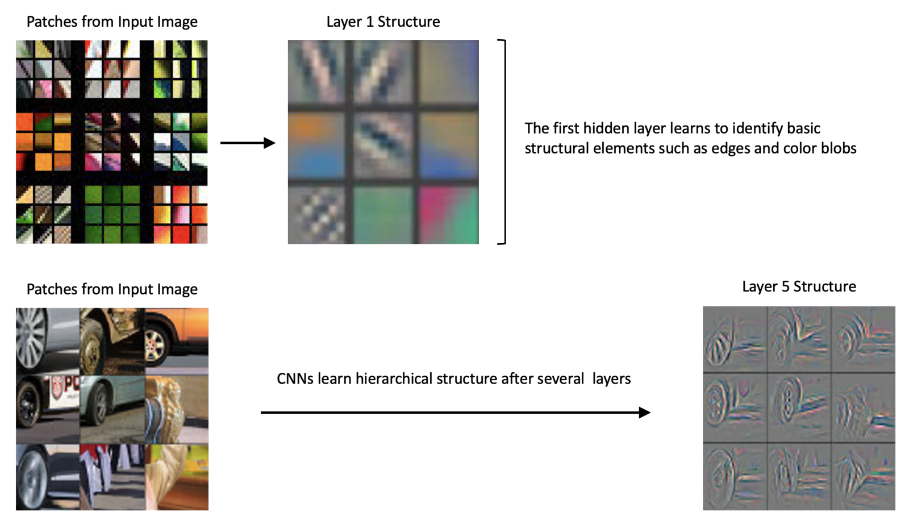
Convolutional Neural Networks
Zeiler, M. D., & Fergus, R. (2014). Visualizing and understanding convolutional networks. In Computer Vision–ECCV 2014: 13th European Conference, Zurich, Switzerland, September 6-12, 2014, Proceedings, Part I 13 (pp. 818-833). Springer International Publishing.
Notes:
Also, here we can see the intermediate layer visualization of a CNN. Initial layers learn basic features such as edges and boundaries. The later layers learn more complex features such as contours.

Slide 12
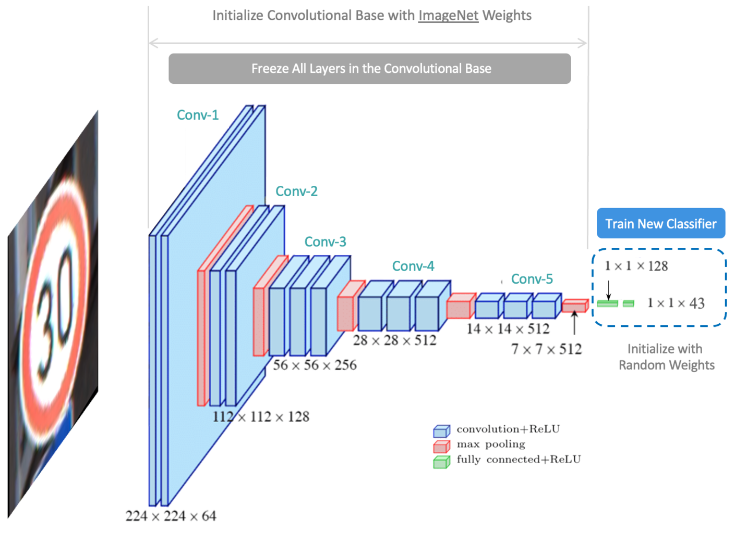
Pre-trained CNNs and Transfer Learning
https://learnopencv.com/understanding-convolutional-neural-networks-cnn/
Notes:
In parallel to the development of CNN architectures, there has been advances in development of huge datasets. Given enough training examples, CNNs are very good at learning the patterns. But to train a model for any task we need huge datasets. ImageNet is such a huge dataset for general purpose object classification. Many CNN architectures are trained on this dataset for the task of object classification. But in many applications , the availability of datasets is limited. We can use transfer learning and use pre-trained CNNs for those tasks.
In the case of transfer learning, we freeze the convolutional base and update the weights of the classification head. The conv head is assumed to have learnt all required features needed for object classification.

Slide 13
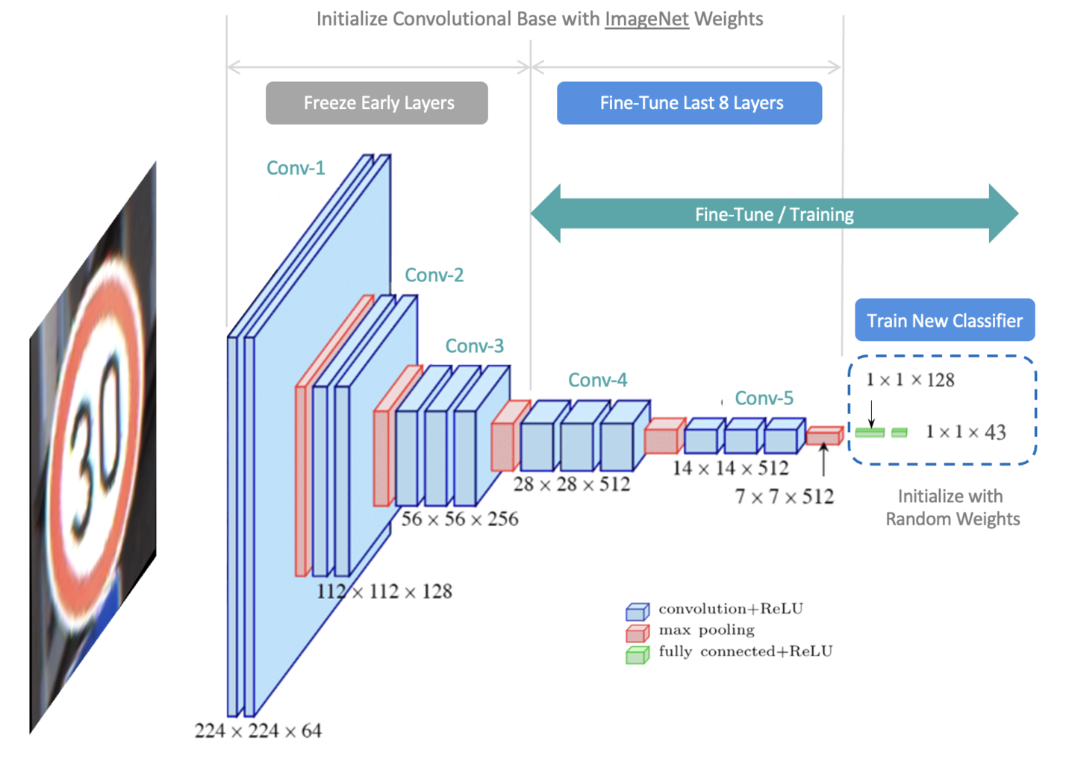
Pre-trained CNNs and Fine-tuning
https://learnopencv.com/understanding-convolutional-neural-networks-cnn/
Notes:
Sometimes, we finetune last few layers of the convolutional base in addition to the classifier. That is called fine-tuning, where we assume the initial layers have learnt basic features such as edges and boundaries and we can use those learning and transfer that knowledge for our task.

Slide 14
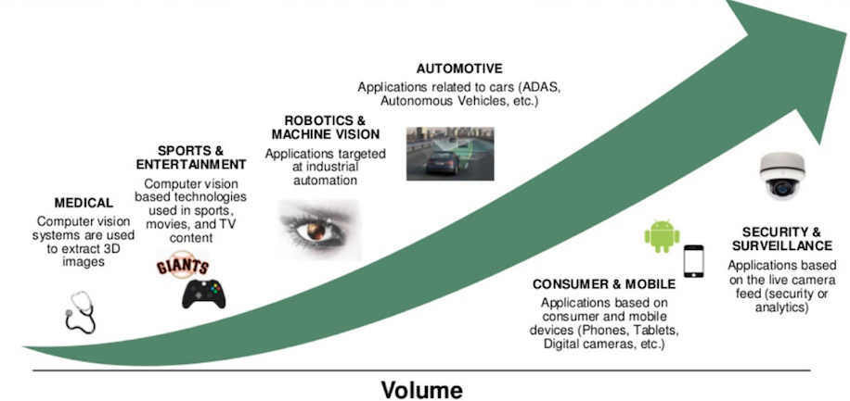
Real-world Applications
Image Classification
Object Detection
Image Segmentation
Notes:
In real world, we have application of CNNs in many fields, starting from security and surveillance to medical diagnosis. We can divide the tasks broadly as image classification, object detection, and image segmentation.

Slide 15
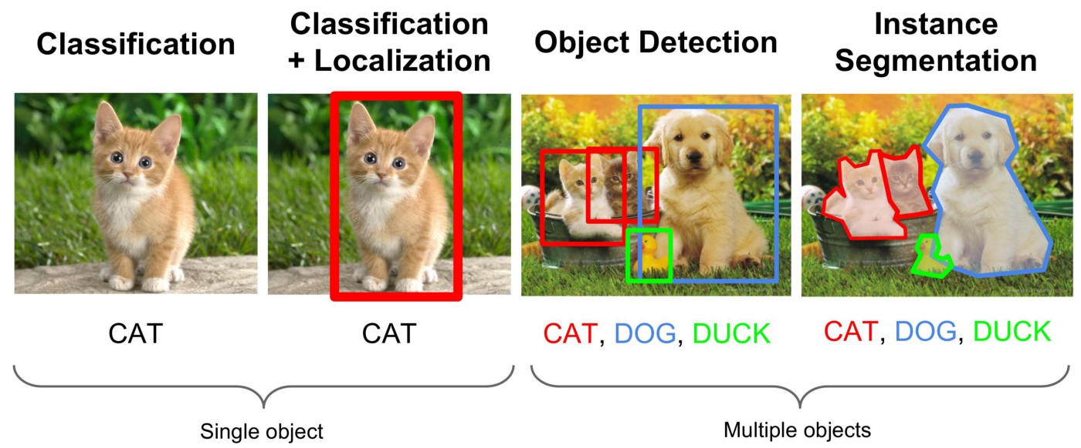
Real-world Applications
Object detection: Identifying and localizing each object
Image segmentation: Dividing an image into distinct regions or objects
Image classification: Assigning objects to predefined classes
Object localization: Identifying an object's position in an image

Slide 16
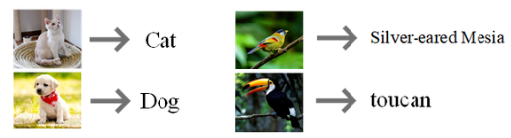
Image classification
Identifying the class of an (object in the) image
https://www.researchgate.net/

Slide 17
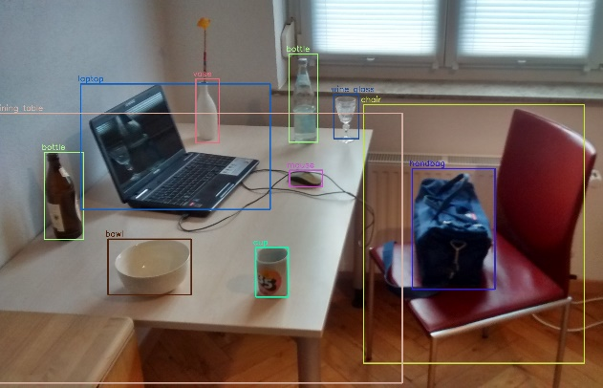
Object Detection
Identifying the class as well as position of an object in the image
https://www.google.com/

Slide 18
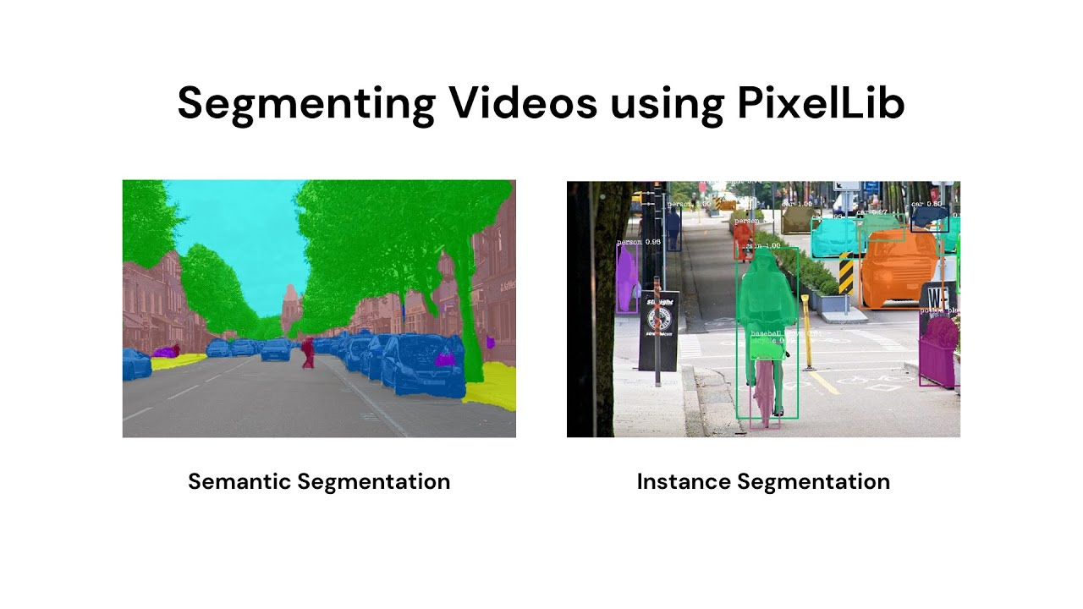
Image Segmentation
Instance Segmentation
Semantic Segmentation
Image segmentation focuses on dividing an image into distinct regions or objects
Predicts the exact shape of an object in an image
https://www.google.com/

Slide 19
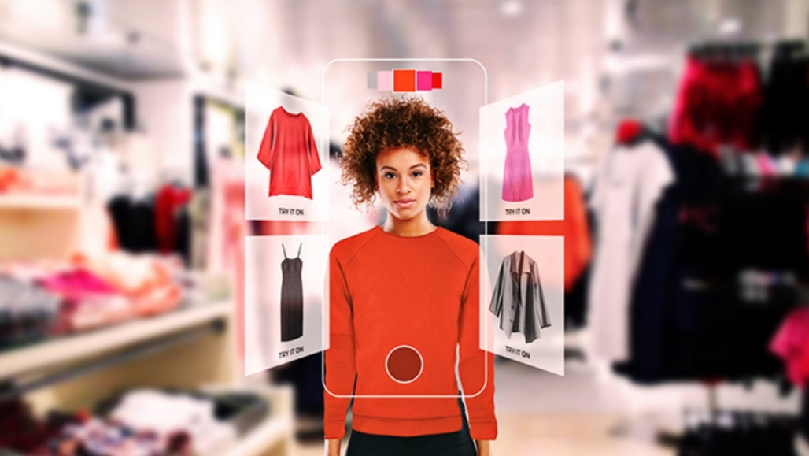
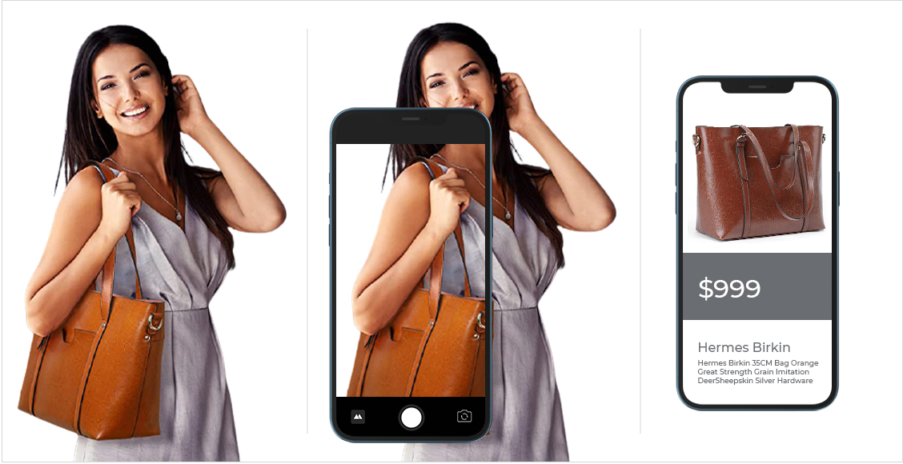
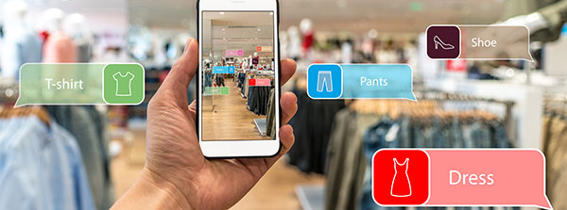
Retail and E-commerce
Product recognition, quality control
Enhancing the shopping experience with augmented reality
https://www.google.com/
Notes:
In the case of retail and e-commerce, CNNs are used in product recognition or classification.

Slide 20
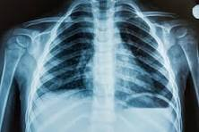
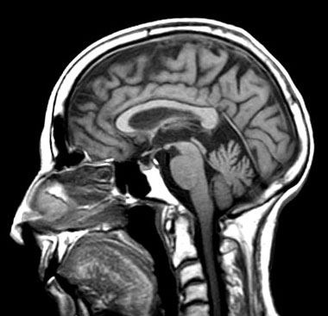
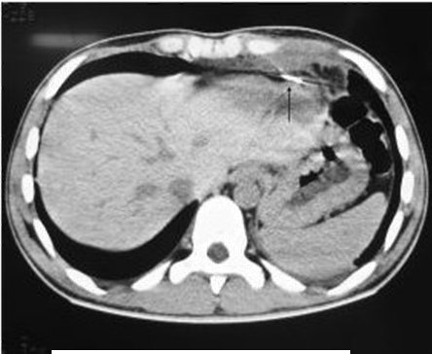
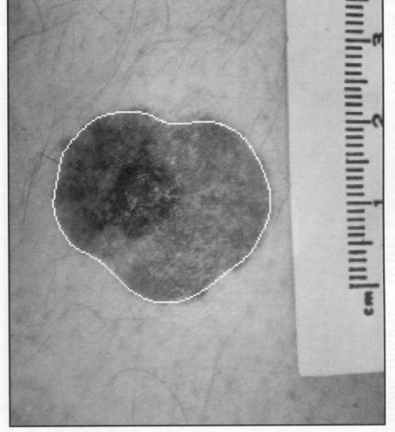
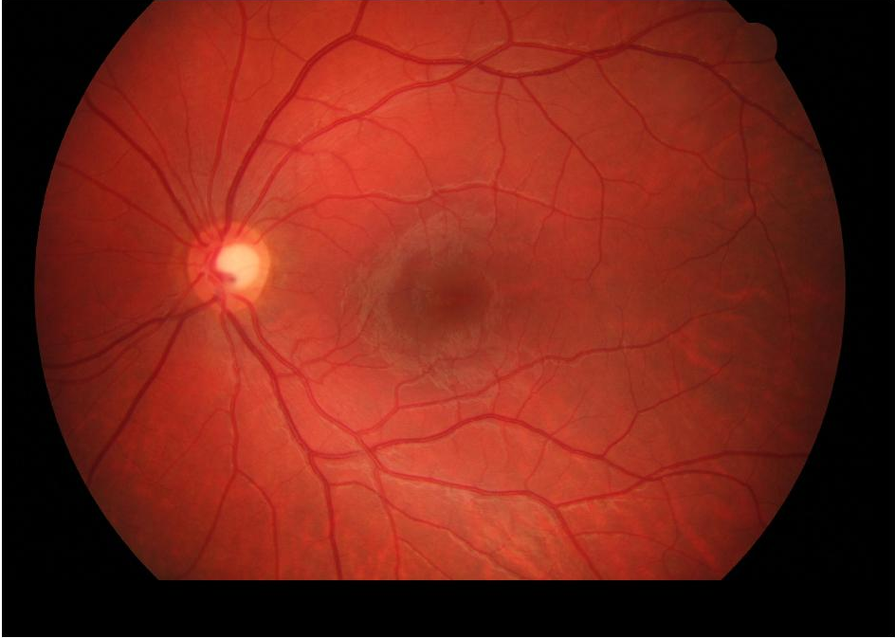
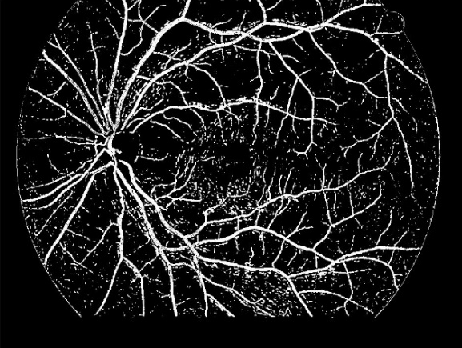
Medical Image Analysis
Disease Diagnosis
Disease Classification
Anomaly Detection
X-ray
MRI
CT Scan
Retinal vessel segmentation from Fundus images
Skin Cancer Detection
Notes:
In medical diagnosis, we can use CNNs for disease diagnosis (presence or absence of disease), disease classification (find type/grade of the disease), anomaly detection (identify patterns whose distribution deviates from the real data).

Slide 21
Model Development
Data Collection
Data Pre-processing
Model Selection
Training and Validation
Model Inference
Notes:
For any application, a typical CNN model development pipeline follows similar steps. The first step is to collect a dataset. Once data is collected, it needs to be pre-processed to ensure it’s clean, structured, and suitable for analysis.
The next task is to select the model, if we have less data, it is better to use a less complex model (with less number of layers and parameters), otherwise this may lead to overfitting. Also, if we opt for transfer learning, then we should use a model which is pretrained on a huge but related dataset. For example, for the task of classifying different cars, we can use a model, pretrained on ImageNet.
Once the model is selected, we have to perform training, where we update the model weights and parameters, using backpropagation. So, given an image and its corresponding target, the predicted output is compared with the actual target and loss is calculated. This loss is then back propagated using stochastic gradient descent and weights and bias are updated in an iterative manner.
Finally, during inference we evaluate the model on the test set which the model has not yet seen. While reporting performance we generally report the performance of the model on the test set.

Slide 22
Data Collection
Large dataset
Diverse
Problem Dependent
Notes:
The first step is to collect a dataset. We have already discussed that CNNs rely on vast amounts of data to learn and make predictions. The quality and quantity of data are crucial for training accurate and reliable CNN-based frameworks.
Especially, to train a CNN from scratch, we need to collect a large dataset with diverse set of samples from each class. If its an unsupervised problem then data samples are enough, however for supervised scenario, we need to collect target labels. If it’s a classification problem, we need to collect class labels along with the data samples, if it’s a regression problem then continuous targets. The target should be appropriate according to the problem that we are trying to solve. For example, in the case of segmentation, the output is a segmentation mask which clearly demarcates different regions within an image. By collecting the large and diverse dataset, we will be able to provide enough instances to the CNN so that the model will be able to learn the patterns. We have also discussed that, for some problems, if we do not have enough examples then we can use pre-trained CNNs and finetune them for our task.

Slide 23
Data Pre-processing
Noise removal
Restoration
Normalization/Standardization
One-hot encoding
Notes:
Once data is collected, it needs to be pre-processed to ensure it’s clean, structured, and suitable for analysis. Preprocessing typically includes resizing the images to a consistent size, normalizing the pixel values, and converting the data into a suitable numerical representation. Resizing the images to a fixed size is necessary to ensure that all input images have the same dimensions, as CNN models require inputs of fixed sizes. Other pre-processing tasks may involve cleaning noisy data, handling missing values, standardizing formats, and encoding categorical variables. Raw data often contain noise and distortions, it is hence important to restore the data samples by removing noise or distortion.
Normalizing the pixel values helps in reducing the effect of lighting variations and brings the data into a common range.

Slide 24
Train, Validation and Test split
Train-Val
Dataset
Test
Notes:
In the training phase, AI models are fed with labeled data (supervised learning) or unlabeled data (unsupervised learning) to learn patterns and relationships. During training, the model adjusts its parameters iteratively to minimize errors and improve its performance on the given task. After training, the AI model is evaluated using separate validation data to assess its performance and generalization ability.
The training set is used to train the CNN model, the validation set is used to fine-tune the model's hyperparameters and monitor its performance during training, and the testing set is used to evaluate the final performance of the trained model. The data should be split in a way that preserves the class distribution and ensures that each set contains representative samples. Typically, a common practice is to allocate around 70-80% of the data for training, 10-15% for validation, and the remaining 10-15% for testing.

Slide 25
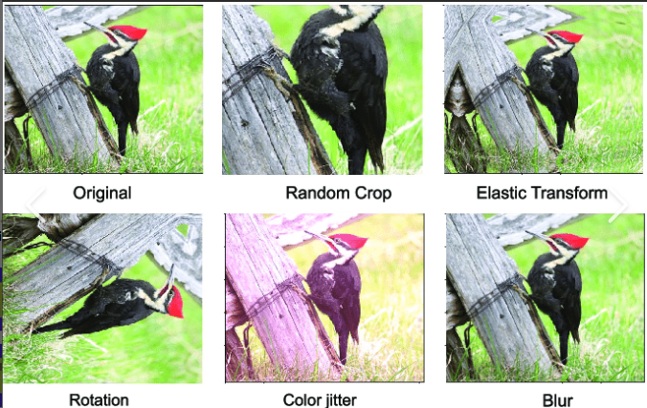
Data augmentation
Geometric transformations
Color space transformations
Filtering
Generative adversarial networks
Notes:
After preprocessing, data augmentation techniques can be applied to increase the diversity and size of the training set.
Data augmentation involves applying random transformations to the existing data. Geometric transformations include rotations, translations, flips, and zooms. Color space translations include change in RGB values, or hue saturation values. Filtering techniques such as blurring are also used to augment the data samples.
Data augmentation is mostly preferred when the number of examples are less or we have imbalanced datasets. The transformations generate new samples that are similar to the original ones but have slight variations. By augmenting the data, we can increase the amount of training data available, which helps in improving the generalization and robustness of the CNN model. Advanced augmentation techniques use generative adversarial networks to transform the images.

Slide 26
Case Study 1 Retail / E-commerce – Visual Product Categorization
Notes:
The first case study that we will discuss today is on the application of CNNs in Retail or E-commerce industry. We will look at the simple case of visual product recognition.

Slide 27
Dataset
fashion-products-small
Hugging Face: https://huggingface.co/datasets/ceyda/fashion-products-small
Original Source: https://www.kaggle.com/datasets/paramaggarwal/fashion-product-images-dataset
Total number of Images: ~42.7K
Categories/Classes
Mastercategory: high-level category like apparel, footwear, accessories
Gender: men, women, unisex
Subcategory: more specific category like topwear, bottomwear, watches, shoes
Notes:
I have used this dataset from Hugging Face with name “fashion-products-small”. There are a total of 42.7 thousand images in this dataset. As you can see, these images have been categorized in terms of multiple aspects such as master category, gender, and subcategory.

Slide 28
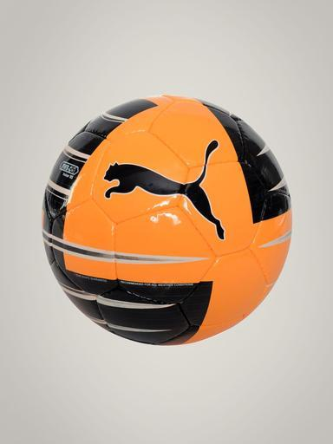
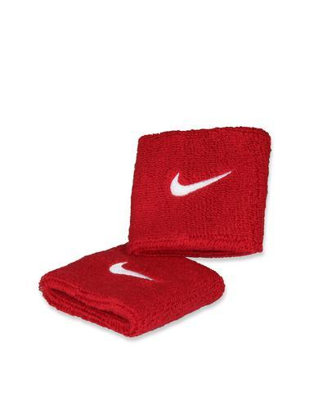
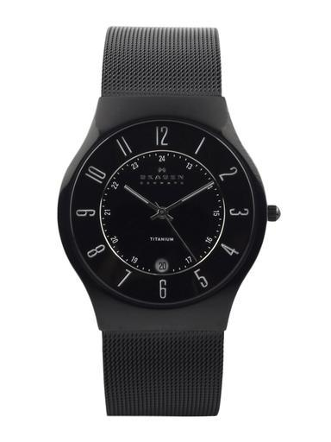
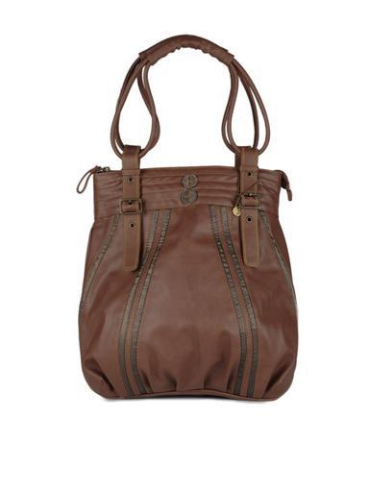
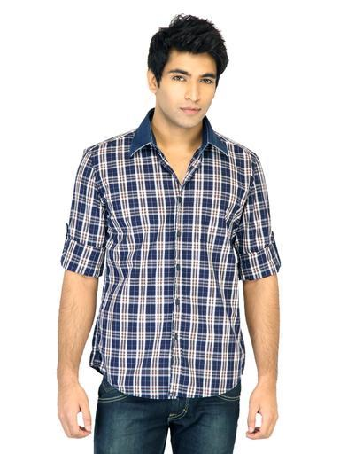
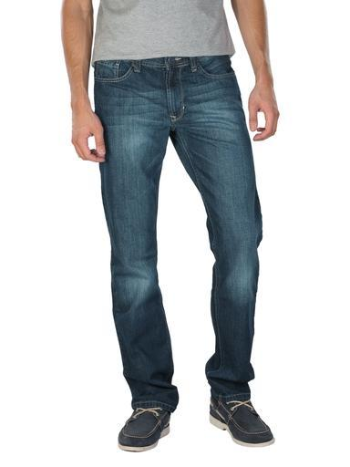
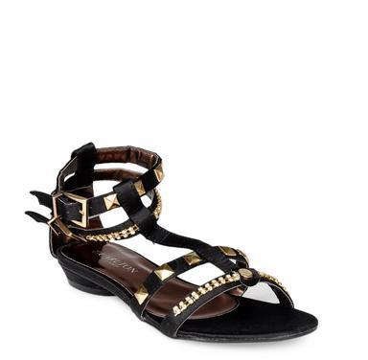
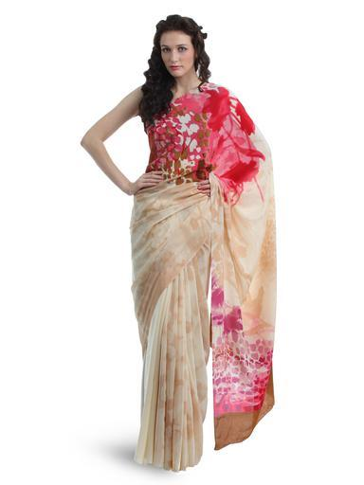
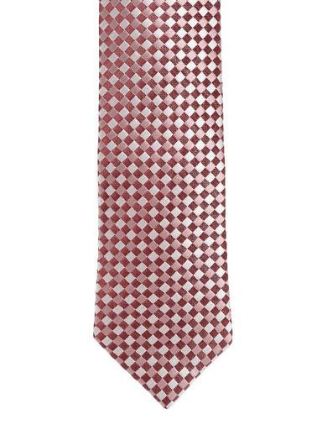
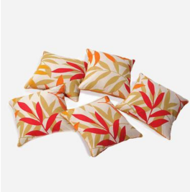
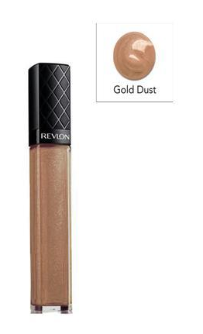
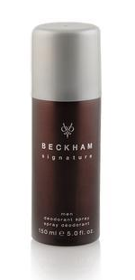
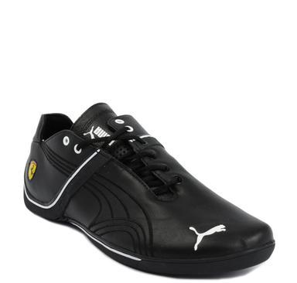
Dataset
Accessories
Sporting Goods
Apparel
Footwear
Home
Personal Care
Free Items
Notes:
I have taken the master category with high-level classes associated with each image.
Here we can see two example images from each category. There are a total of 7 classes: Apparel, sporting goods, accessories, personal care, home furnishing, and footwear. Free items in this dataset are not from a particular type of product, perhaps, they have been in offer, like many e-commerce websites have.

Slide 29
Dataset
Sl. No. | Category | Number of images
1 | Apparel | 20332
2 | Accessories | 11133
3 | Footwear | 9177
4 | Personal Care | 1929
5 | Free Items | 103
6 | Sporting Goods | 25
7 | Home | 1
 | Total | 42700
Notes:
Let’s look into the data distribution here, interestingly, the number of images from sporting goods and home are very less. So, as a part of data preparation, we have to remove them. Of course in a highly imbalanced dataset, we should apply methods such as data augmentation, but as the number of images are too less, data augmentation will not be able to add much variation (imagine the difference 1:20332). Additionally, we will remove images from free items class.

Slide 30
Data Preparation
Filter out images from ‘Home’, ‘Sporting Goods’ and ‘Free Items’ categories
Sl. No. | Category | Number of images
1 | Apparel | 20332
2 | Accessories | 11133
3 | Footwear | 9177
4 | Personal Care | 1929
 | Total | 42571
Multiclass image classification
#Classes = 4
Notes:
So, after filtering out images from ‘Home’, ‘Sporting Goods’ and ‘Free Items’ categories, we have a total of 42571 images from 4 categories.

Slide 31
Problem Formulation
Task: Multiclass image classification Input: Product images Output: Product category label
Apparel
Footwear
Accessories
Personal Care
Notes:
In terms of computer vision, this problem reduced to a multiclass image classification problem, where the input is an image of a product and the output is the class to which the image belongs to.

Slide 32
Train-Validation-Test Split
80:20 stratified sampling
Data | Number of images
Training Set | 27244
Validation Set | 6812
Test Set | 8515
Total | 42571
Notes:
Next, we will split the entire dataset into training, validation, and test sets. It’s a good practice to follow stratified sampling, where equal percentage of images from each class will be used in the training and test set. This process retains the original data distribution. The entire dataset is first split into training and validation set using 80:20 stratified split, again the training set is split into training and validation, using 80:20 split. The table shows the number of images present in each set.

Slide 33
Train-Validation-Test Split
Sl. No. | Category | #images in Validation Set
1 | Apparel | 3253
2 | Accessories | 1781
3 | Footwear | 1469
4 | Personal Care | 309
 | Total | 6812
Sl. No. | Category | #images in Training Set
1 | Apparel | 13012
2 | Accessories | 7125
3 | Footwear | 5873
4 | Personal Care | 1234
 | Total | 27244
Sl. No. | Category | # images in Test Set
1 | Apparel | 4067
2 | Accessories | 2227
3 | Footwear | 1835
4 | Personal Care | 386
 | Total | 8515
Notes:
Here, we can see the number of images from each class present in the training, validation, and test set. The training set is still an imbalanced dataset, so we will have to perform some data augmentation.

Slide 34
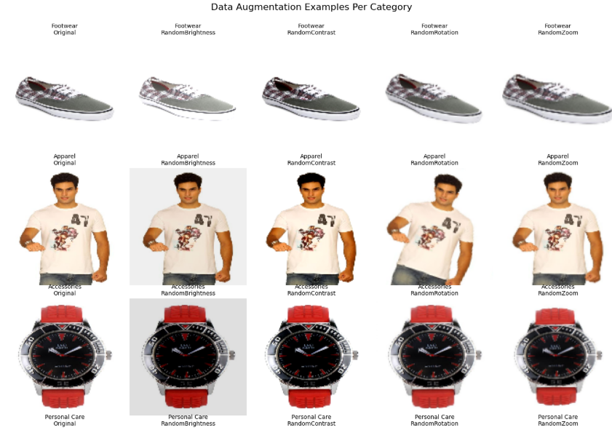
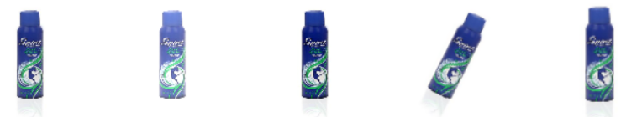
Data Augmentation
Original
Image
Random
Brightness
Random
Contrast
Random
Rotation
Random
Zoom
Notes:
This figure shows the example image and its augmented counter parts. These augmentations are done with some probability value, showing the impact of augmentation on the entire training set.

Slide 35
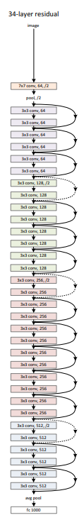
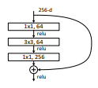
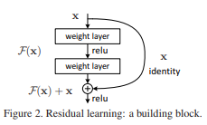
ResNet
Notes:
We have selected a ResNet50 model, the figure shows that of a ResNet34, ResNet50 has similar connections. The core idea of ResNet is the use of residual blocks, which allow the network to learn residual functions with reference to the layer inputs. This helps in addressing the vanishing gradient problem, making it possible to train very deep networks. ResNet introduces skip connections (or shortcut connections) that bypass one or more layers. These connections help in stabilizing the training of deep networks and enable the construction of networks with hundreds of layers. The architecture is also missing fully connected layers at the end of the network. During forward pass the residual block lets the convolutional layers learn identity functions, thereby reducing complexity of the model. ResNets are currently by far state of the art CNN models and are widely used in various applications.

Slide 36
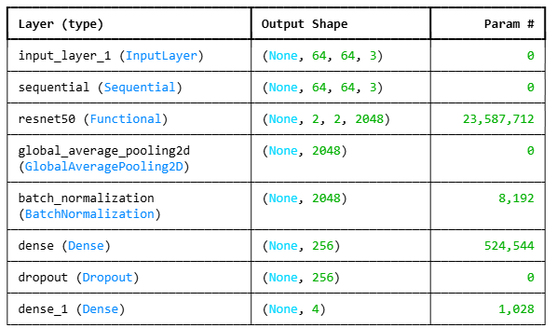
ResNet + Transfer Learning
Total params: 24,121,476
Trainable params: 529,668
Non-trainable params: 23,591,808
Notes:
Here I have used the pretrained ResNet50 model trained on the ImageNet dataset and freezed the convolutional feature extractor. On top of it, I have used a global average pooling layer, which simply takes average of the feature map across the 2 by 2 spatial dimension. So the result of this layer is a 1D vector of dimension 2048. Then I have added a fully connected layer with only 256 neurons.
Batch Normalization normalizes the activations of a layer so that they have zero mean and unit variance. During training, as weights change, the distribution of activations in intermediate layers keeps shifting. This causes: Slow convergence, Sensitivity to learning rate, Vanishing / exploding gradients. This problem is called Internal Covariate Shift. The benefits of this layer are: Faster convergence, Allows higher learning rates, Reduces vanishing/exploding gradients, Acts as regularization (often reduces need for dropout), Improves generalization.
I have also added a dropout layer with 0.5 probability. Dropout randomly “turns off” a fraction of neurons during training to prevent overfitting and encourage robust feature learning.

Slide 37

Loss Function
Categorical cross-entropy loss function
Notes:
Categorical cross-entropy is a commonly used loss function for multiclass classification problems, where each input belongs to exactly one class out of C possible classes. It measures the discrepancy between the true class distribution and the predicted probability distribution produced by the model. In this setting, the true labels are represented using one-hot encoding, and the model typically uses a softmax activation in the output layer to generate class probabilities.
For a single training example, the categorical cross-entropy loss is defined as shown in the equation. where yi​ is the ground-truth one-hot label and y^i​ is the predicted probability for class i. Since only the true class has yi=1, the loss effectively penalizes the model based on the negative log probability assigned to the correct class. Categorical cross-entropy strongly encourages the model to assign high probability to the correct class and low probability to all others, making it well suited for probabilistic interpretation and gradient-based optimization.

Slide 38
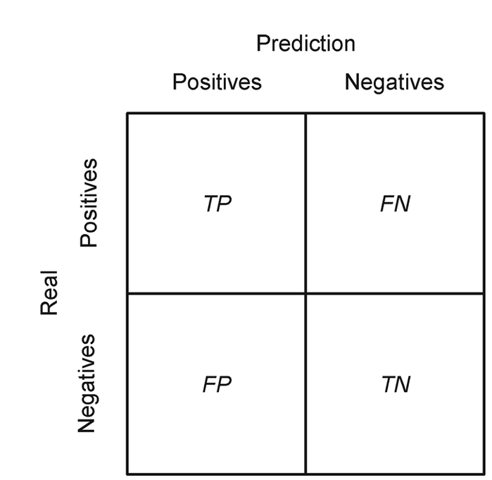
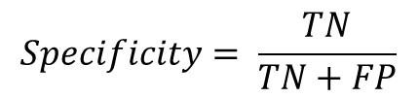

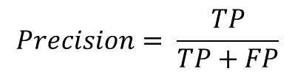
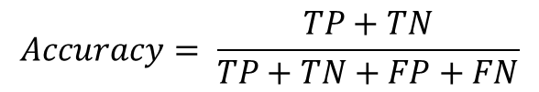

Classification Metrics
$$Accuracy= \frac{TP+TN}{TP+TN+FP+FN}$$
$$Precision= \frac{TP}{TP+FP}$$
how many of the instances predicted as positive
are actually positive
$$Recall/Sensitivity= \frac{TP}{TP+FN}$$
proportion of true positives detected out of all the actual positive instances
$$Specificity= \frac{TN}{TN+FP}$$
$$F1−Score=\frac{2PR}{P+R}$$
proportion of actual negative instances that are correctly identified by the model
Notes:
Accuracy measures how often the model’s predictions are correct overall. Precision focuses on the quality of the model’s positive predictions. It tells us how many of the instances predicted as positive are actually positive. Recall measures how well the model identifies all actual positive cases. It shows the proportion of true positives detected out of all the actual positive instances. It is also called True Positive Rate (TPR) or sensitivity. True Negative Rate (TNR) or Specificity is a metric used to evaluate the performance of a classification model. It measures the proportion of actual negative instances that are correctly identified by the model.

Slide 39




Classification Metrics
$$FNR= \frac{FN}{FN+TP}$$
proportion of actual positive instances that are incorrectly classified as negative by the model
$$TPR=1−FNR=\frac{TP}{TP+FN}=Recall/Sensitivity$$
$$FPR=1−specificity=\frac{FP}{TN+FP}$$
proportion of actual negative instances that are incorrectly classified as positive by the model
Notes:
False Positive Rate (FPR) measures the proportion of actual negative instances that are incorrectly classified as positive by the model. It indicates the likelihood of a false alarm. False Negative Rate (FNR) measures the proportion of actual positive instances that are incorrectly classified as negative by the model. It indicates the likelihood of missing a positive case.
An ROC curve (Receiver Operating Characteristic) is a graph that visualizes the performance of a classification model by plotting the true positive rate (sensitivity) on the y-axis against the false positive rate (1 - specificity) on the x-axis at all possible threshold settings. The curve shows the trade-off between these two metrics and helps in selecting the optimal threshold, with a perfect classifier represented by a point in the upper-left corner (0,1). The area under the curve (AUC) provides a single quantitative measure of the model's overall ability to distinguish between positive and negative classes.
For a given classifier, a model often outputs a score or probability rather than a direct binary prediction. A threshold is used to convert this score into a positive or negative class. The ROC curve examines all possible threshold values. At each threshold, the model's performance is evaluated, resulting in a set of true positive rates and false positive rates. The true positive rate (sensitivity) is plotted on the vertical (y) axis, and the false positive rate (1-specificity) is plotted on the horizontal (x) axis.

Slide 40


Classification Metrics
Notes:
In the case of imbalanced datasets, it is necessary to use average precision or recall metrics. For multiclass classification, these metrics are calculated in terms of one versus rest classification, for a given class c, other classes are considered as negative and so on.

Slide 41


Training and Validation Result
Notes:
I have We can see the training and validation metrics versus epochs of the model.

Slide 42



Performance on the Test Set
Metrics | Multi-class
Loss | 0.1452
Accuracy | 95.69%
'Apparel'
'Accessories'
'Footwear'
'Personal Care'
$$Precision= \frac{TP}{TP+FP}$$
$$Recall/Sensitivity= \frac{TP}{TP+FN}$$

Slide 43

Performance on the Test Set
'Apparel'
'Accessories'
'Footwear'
'Personal Care'

Slide 44

Performance on the Test Set
'Apparel'
'Accessories'
'Footwear'
'Personal Care'
Macro ROC AUC: 0.9957

Slide 45
Case Study 2 Detection of Diabetic Retinopathy

Slide 46
Dataset
APTOS 2019 Blindness Detection Dataset, which contains high-resolution retinal images labeled with DR severity:
0: No DR
1: Mild
2: Moderate
3: Severe
4: Proliferative DR
Lets use it for binary classification: No DR and DR

Slide 47

Dataset
DR
No DR

Slide 48
Dataset
Data | Class | Number of images
Training Set | DR | 1050
 | No DR | 1026
 | Total | 2076
Validation Set | DR | 245
 | No DR | 286
 | Total | 531
Test Set | DR | 113
 | No DR | 118
 | Total | 231

Slide 49

MobileNet
Depthwise separable convolutions: a depthwise convolution that applies a single filter to each input channel independently, followed by a pointwise (1×1) convolution that combines information across channels
Notes:
MobileNet is a lightweight convolutional neural network architecture designed for efficient deployment on mobile and edge devices. The key idea behind MobileNet is the use of depthwise separable convolutions, which decompose a standard convolution into two steps: a depthwise convolution that applies a single filter to each input channel independently, followed by a pointwise (1×1) convolution that combines information across channels. This factorization drastically reduces the number of parameters and computational cost compared to standard convolutions, while retaining good representational power. The architecture consists of an initial standard convolution followed by multiple depthwise–pointwise convolution blocks, with batch normalization and non-linear activations applied after each layer, and ends with global average pooling instead of heavy fully connected layers. Overall, MobileNet provides an excellent balance between accuracy, speed, and model size, making it well suited for real-time and resource-constrained applications.

Slide 50

MobileNet
Total params: 3,229,889
Trainable params: 3,208,001
Non-trainable params: 21,888
Notes:
Compared to the ResNet 50 model, this CNN has much less number of parameters. We are going to train this model from scratch, that means the parameters are randomly initialized.

Slide 51

Loss Function
Binary cross-entropy loss function
Notes:
Binary cross-entropy is a loss function used for binary classification problems, where each input belongs to one of two classes, typically labeled as 0 and 1. It measures how well the predicted probability of the positive class matches the true binary label. The model usually ends with a sigmoid activation function, which outputs a probability value between 0 and 1. For a single training example, the binary cross-entropy loss is defined as shown in the equation. where y∈{0,1} is the ground-truth label and y^​ is the predicted probability of the positive class. The loss penalizes confident but incorrect predictions very strongly, encouraging the model to output probabilities close to 1 for positive samples and close to 0 for negative samples.

Slide 52


Training and Validation Result
Notes:
I have We can see the training and validation plots.

Slide 53

Performance on the Test Set
Metrics | Multi-class
Loss | 0.6394
Accuracy | 61.47%
‘DR'
‘No_DR'
$$Precision= \frac{TP}{TP+FP}$$
$$Recall/Sensitivity= \frac{TP}{TP+FN}$$

Slide 54

Performance on the Test Set
‘DR'
‘No_DR'

Slide 55

Performance on the Test Set
‘DR'
‘No_DR'
ROC AUC: 0.6094

Slide 56
Discussion

Slide 57
References
“Deep Learning”, An MIT Press book, Ian Goodfellow and Yoshua Bengio and Aaron Courville, http://www.deeplearningbook.org
https://onlinecourses.nptel.ac.in/noc22_cs124/preview
“Neural Networks and Deep Learning”, Aggarwal, C. C. , 2018.
"Gradient-Based Learning Applied to Document Recognition" by Yann LeCun, Léon Bottou, Yoshua Bengio, and Patrick Haffner.
Zeiler, M. D., & Fergus, R. (2014). Visualizing and understanding convolutional networks. In Computer Vision–ECCV 2014: 13th European Conference, Zurich, Switzerland, September 6-12, 2014, Proceedings, Part I 13 (pp. 818-833). Springer International Publishing.

Slide 58
Thank You

